Slide 1

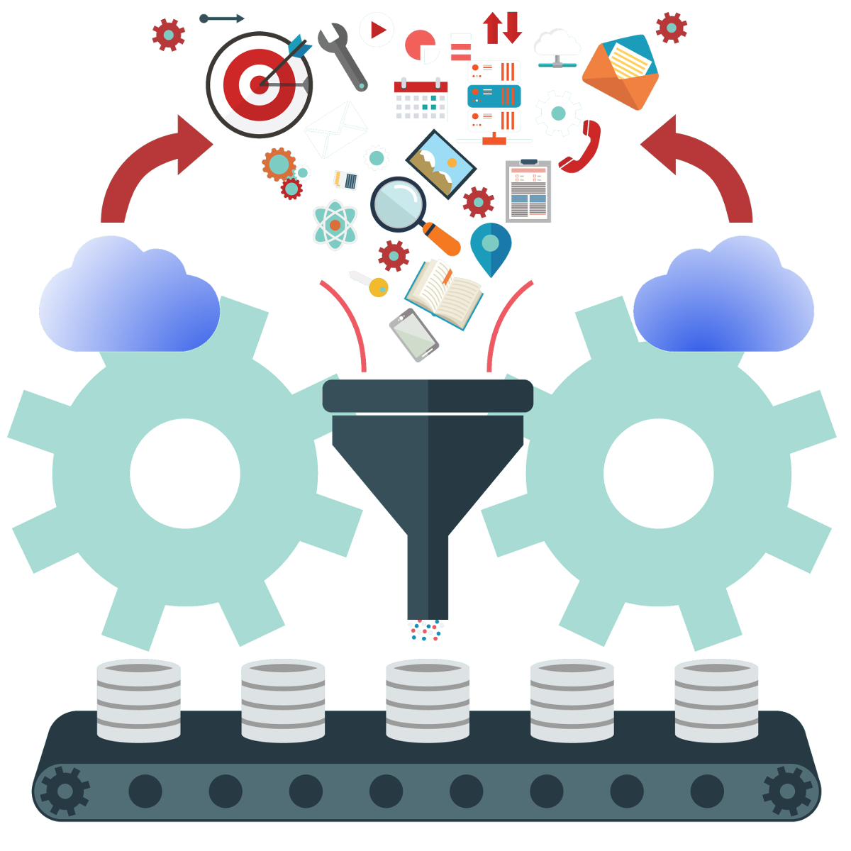

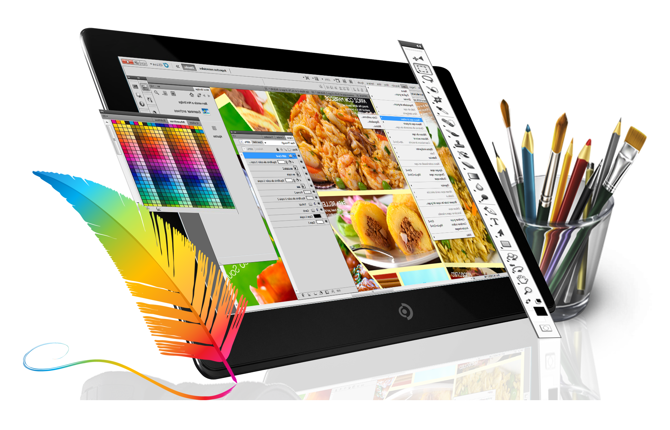
Web Development front-end native stack

Slide 2


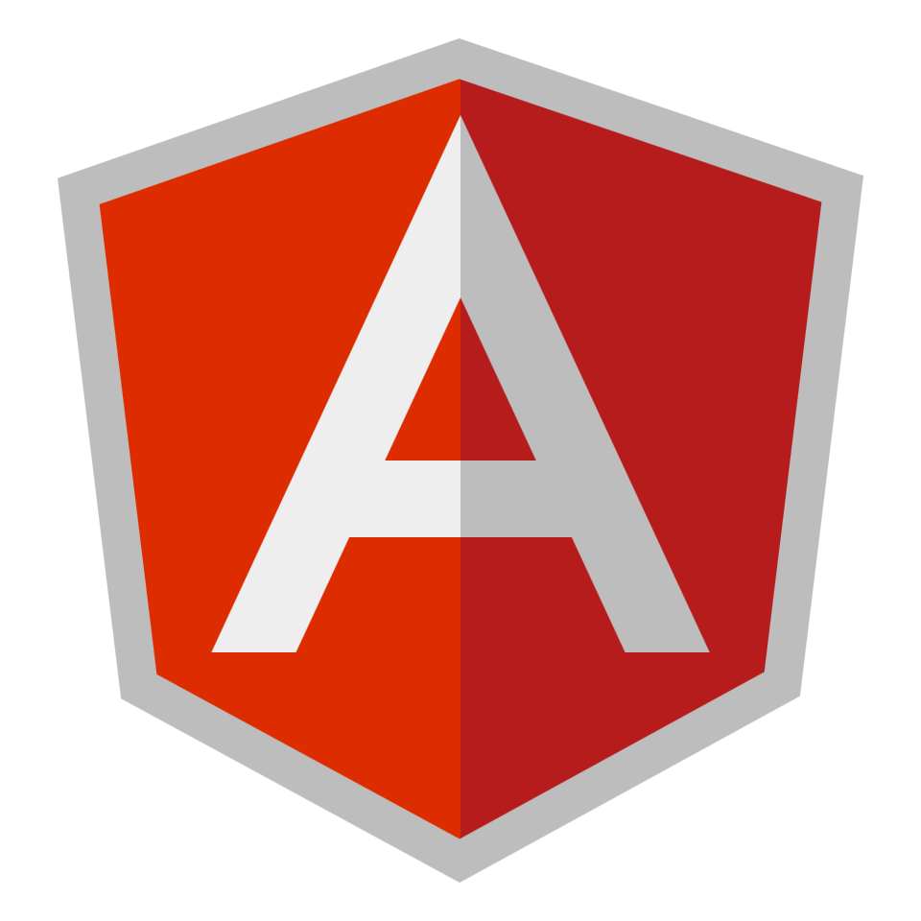
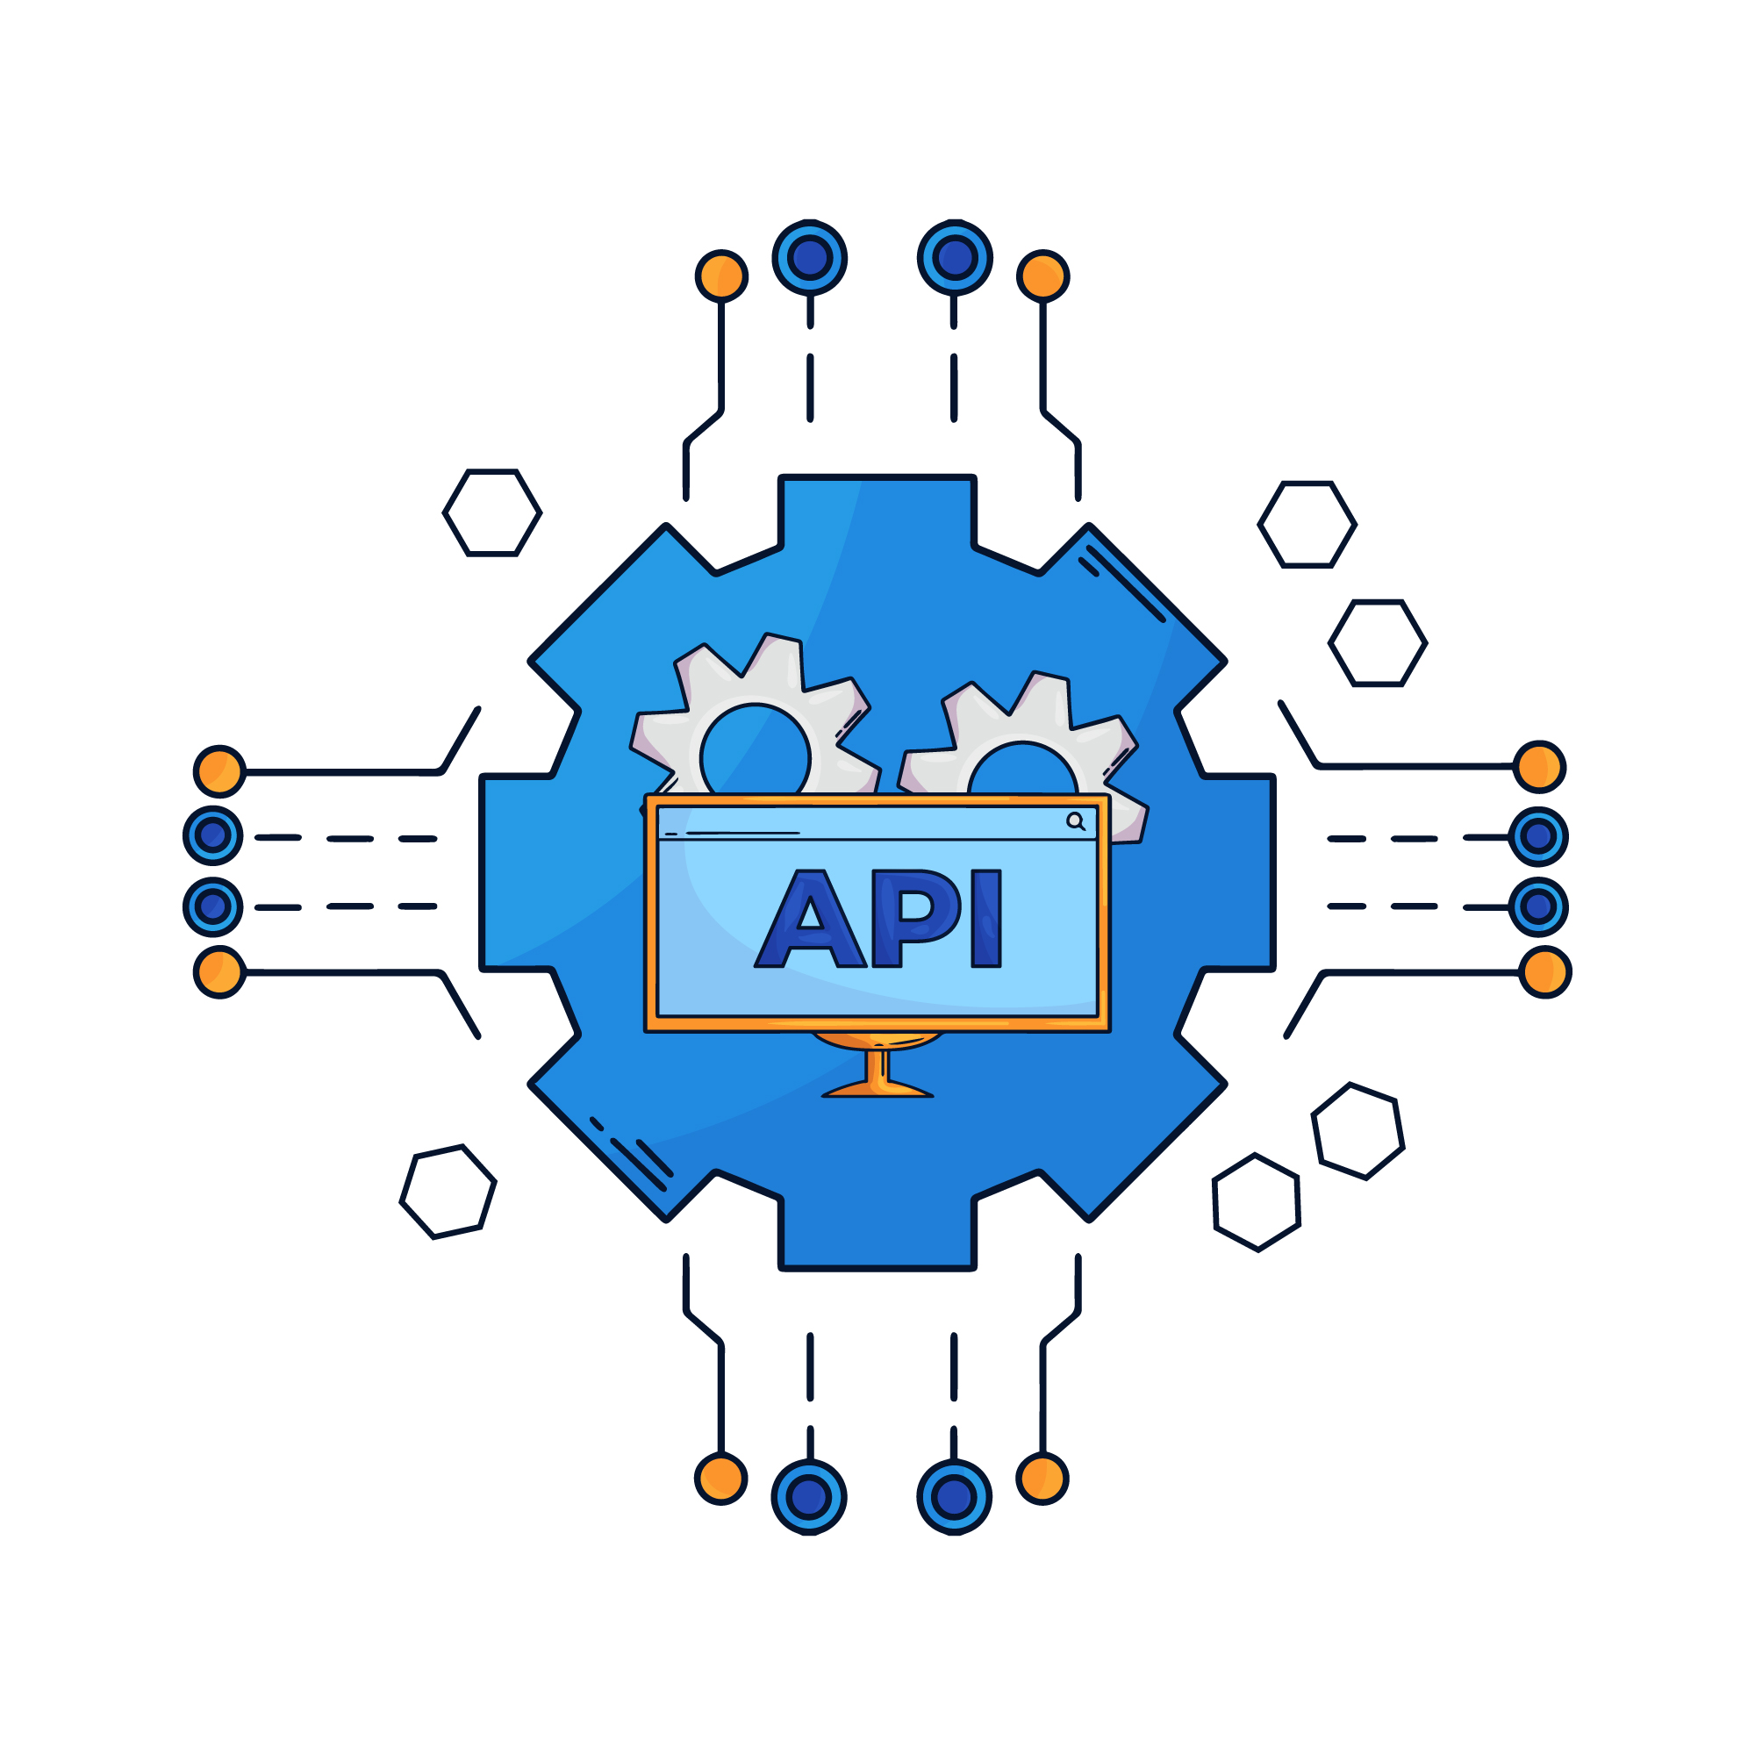
Js intro

Slide 3
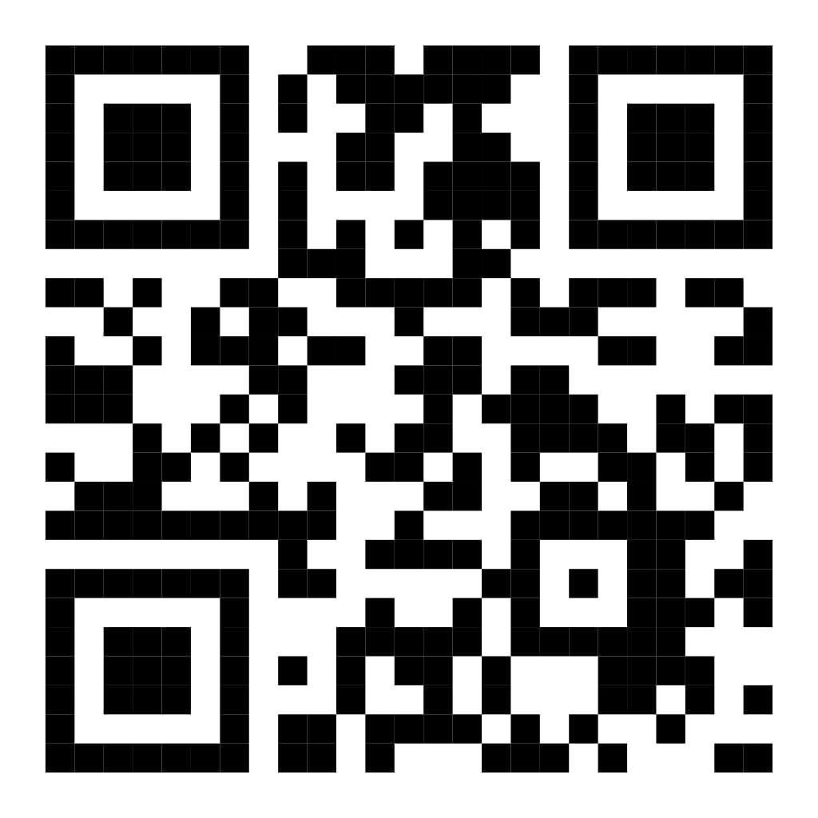
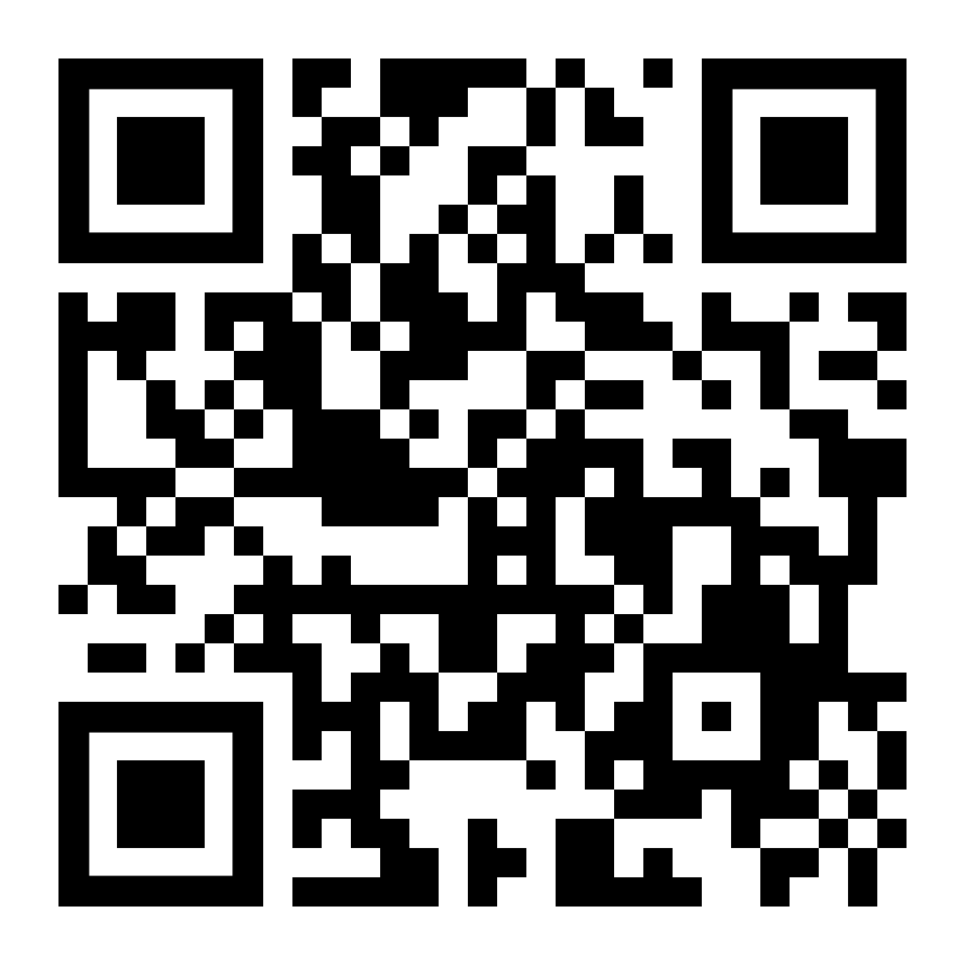
Instructors
Eng. Ahmed Mohamed Abu-Bakr
IC Layout engineer
Full stack web developer Laravel-react
Eng. Nada Harby Motawe
Computer science engineer
Full stack web developer

Slide 4
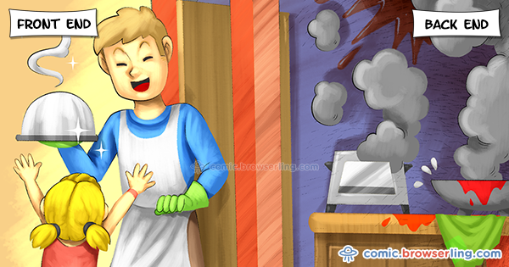

Slide 5
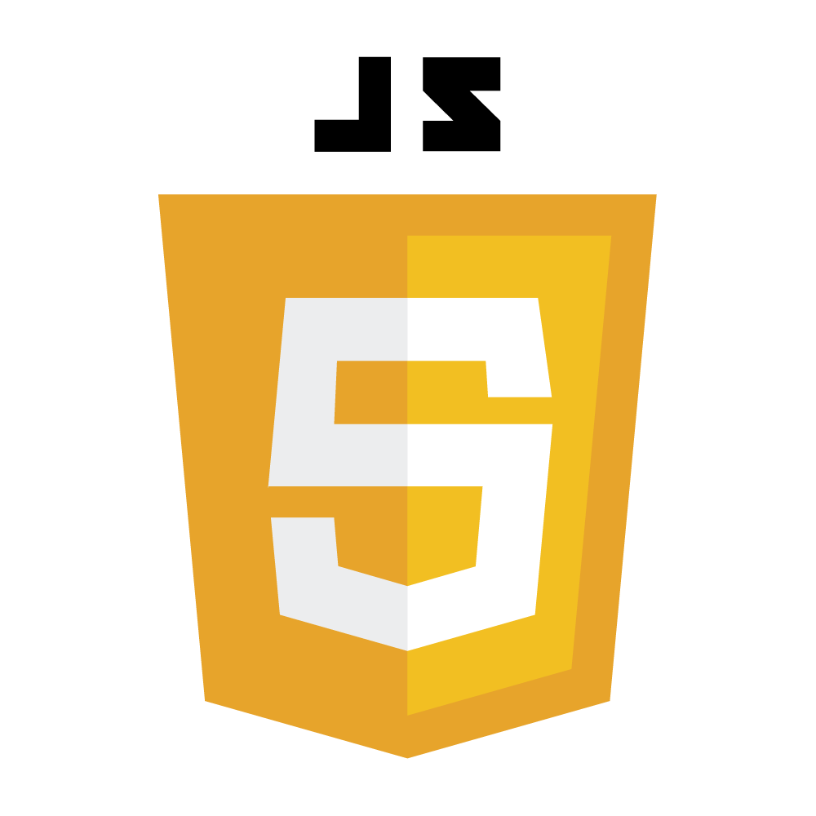
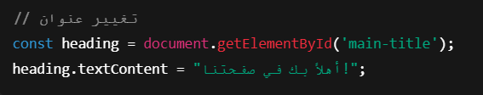
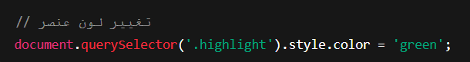
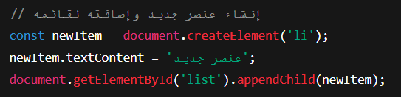
Day 4: DOM Recap – What, Why & How
الـ DOM هو شكل الشجرة اللي بيشوف بيه JavaScript عناصر الصفحة. تقدر تتعامل مع العناصر (زي النصوص، الأزرار، الصور) وتغيرها أو تضيف وتحذف منها في أي وقت. ده اللي بيخلي صفحاتنا تفاعلية مش مجردHTML ثابت.
Notes:
Syntax is crucial in programming for several reasons:
Clarity and Readability: Syntax provides a structured way to write code, making it easier for programmers to read and understand. Consistent syntax helps convey the intended logic and flow of the program.
Error Reduction: Strict syntax rules help catch errors early in the development process. If the syntax is incorrect, the compiler or interpreter will typically provide feedback, preventing the program from running until the issues are resolved.
Language Definition: Each programming language has its own syntax that defines how code is structured. This syntax is part of what distinguishes one language from another and defines how programmers interact with the language's features.
Tooling and Support: Many development tools, such as IDEs and linters, rely on the syntax of a programming language to provide features like code completion, syntax highlighting, and error detection. Changing the syntax could disrupt these tools' effectiveness.

Slide 6
Day 4: DOM Recap – What, Why & How
🧠 Task 1 – DOM
❓ السؤال:
أنشئ صفحة فيها زر عند الضغط عليه يتم إضافة عنصر جديد إلى قائمة غير مرتبة (<ul>). كل ضغطة تضيف عنصر جديد تلقائيًا.
Notes:
Syntax is crucial in programming for several reasons:
Clarity and Readability: Syntax provides a structured way to write code, making it easier for programmers to read and understand. Consistent syntax helps convey the intended logic and flow of the program.
Error Reduction: Strict syntax rules help catch errors early in the development process. If the syntax is incorrect, the compiler or interpreter will typically provide feedback, preventing the program from running until the issues are resolved.
Language Definition: Each programming language has its own syntax that defines how code is structured. This syntax is part of what distinguishes one language from another and defines how programmers interact with the language's features.
Tooling and Support: Many development tools, such as IDEs and linters, rely on the syntax of a programming language to provide features like code completion, syntax highlighting, and error detection. Changing the syntax could disrupt these tools' effectiveness.

Slide 7
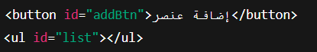
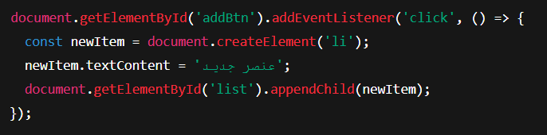
Day 4: DOM Recap – What, Why & How
✅ Answer 1 – DOM html
Notes:
Syntax is crucial in programming for several reasons:
Clarity and Readability: Syntax provides a structured way to write code, making it easier for programmers to read and understand. Consistent syntax helps convey the intended logic and flow of the program.
Error Reduction: Strict syntax rules help catch errors early in the development process. If the syntax is incorrect, the compiler or interpreter will typically provide feedback, preventing the program from running until the issues are resolved.
Language Definition: Each programming language has its own syntax that defines how code is structured. This syntax is part of what distinguishes one language from another and defines how programmers interact with the language's features.
Tooling and Support: Many development tools, such as IDEs and linters, rely on the syntax of a programming language to provide features like code completion, syntax highlighting, and error detection. Changing the syntax could disrupt these tools' effectiveness.

Slide 8
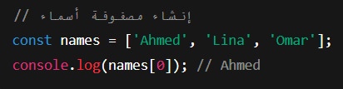
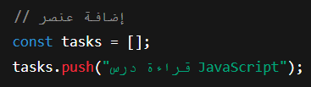
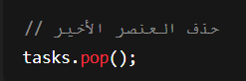
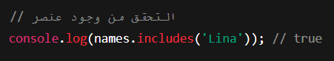
Day 4: Arrays – Data Storage Superpower
الـ Arrays بتخلينا نخزن مجموعة بيانات في متغير واحد. بدل ما تعمل متغير لكل عنصر، بتحطهم كلهم في ترتيب. نستخدمها لتخزين المهام، الأسماء، المنتجات… أي حاجة متكررة.
Notes:
Syntax is crucial in programming for several reasons:
Clarity and Readability: Syntax provides a structured way to write code, making it easier for programmers to read and understand. Consistent syntax helps convey the intended logic and flow of the program.
Error Reduction: Strict syntax rules help catch errors early in the development process. If the syntax is incorrect, the compiler or interpreter will typically provide feedback, preventing the program from running until the issues are resolved.
Language Definition: Each programming language has its own syntax that defines how code is structured. This syntax is part of what distinguishes one language from another and defines how programmers interact with the language's features.
Tooling and Support: Many development tools, such as IDEs and linters, rely on the syntax of a programming language to provide features like code completion, syntax highlighting, and error detection. Changing the syntax could disrupt these tools' effectiveness.

Slide 9
Day 4: DOM Recap – What, Why & How
🧠 Task 2 – Arrays
❓ السؤال:
أنشئ مصفوفة تحتوي على 4 ألوان، ثم أضف لون خامس، واطبع أول لون وآخر لون فيها.
Notes:
Syntax is crucial in programming for several reasons:
Clarity and Readability: Syntax provides a structured way to write code, making it easier for programmers to read and understand. Consistent syntax helps convey the intended logic and flow of the program.
Error Reduction: Strict syntax rules help catch errors early in the development process. If the syntax is incorrect, the compiler or interpreter will typically provide feedback, preventing the program from running until the issues are resolved.
Language Definition: Each programming language has its own syntax that defines how code is structured. This syntax is part of what distinguishes one language from another and defines how programmers interact with the language's features.
Tooling and Support: Many development tools, such as IDEs and linters, rely on the syntax of a programming language to provide features like code completion, syntax highlighting, and error detection. Changing the syntax could disrupt these tools' effectiveness.

Slide 10
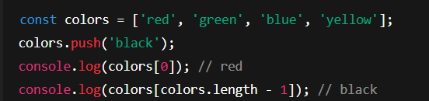
Day 4: DOM Recap – What, Why & How
✅ Answer 2 – Arrays
Notes:
Syntax is crucial in programming for several reasons:
Clarity and Readability: Syntax provides a structured way to write code, making it easier for programmers to read and understand. Consistent syntax helps convey the intended logic and flow of the program.
Error Reduction: Strict syntax rules help catch errors early in the development process. If the syntax is incorrect, the compiler or interpreter will typically provide feedback, preventing the program from running until the issues are resolved.
Language Definition: Each programming language has its own syntax that defines how code is structured. This syntax is part of what distinguishes one language from another and defines how programmers interact with the language's features.
Tooling and Support: Many development tools, such as IDEs and linters, rely on the syntax of a programming language to provide features like code completion, syntax highlighting, and error detection. Changing the syntax could disrupt these tools' effectiveness.

Slide 11
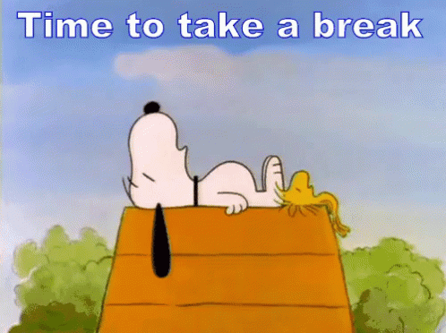
🍵 Break
Notes:
Syntax is crucial in programming for several reasons:
Clarity and Readability: Syntax provides a structured way to write code, making it easier for programmers to read and understand. Consistent syntax helps convey the intended logic and flow of the program.
Error Reduction: Strict syntax rules help catch errors early in the development process. If the syntax is incorrect, the compiler or interpreter will typically provide feedback, preventing the program from running until the issues are resolved.
Language Definition: Each programming language has its own syntax that defines how code is structured. This syntax is part of what distinguishes one language from another and defines how programmers interact with the language's features.
Tooling and Support: Many development tools, such as IDEs and linters, rely on the syntax of a programming language to provide features like code completion, syntax highlighting, and error detection. Changing the syntax could disrupt these tools' effectiveness.

Slide 12
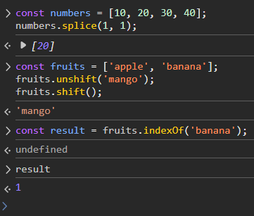
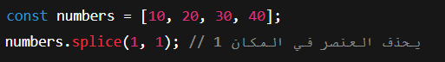
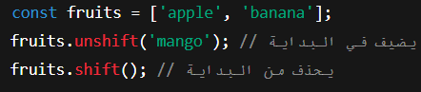
Day 4: Modifying Arrays – Methods You Must Know
JavaScript فيها طرق جاهزة تساعدنا نضيف، نحذف، نفلتر، ونعدل في المصفوفات. من غير ما نكتب لوب كل مرة.
array.splice(start, deleteCount, item1, ..., itemN)
Notes:
Syntax is crucial in programming for several reasons:
Clarity and Readability: Syntax provides a structured way to write code, making it easier for programmers to read and understand. Consistent syntax helps convey the intended logic and flow of the program.
Error Reduction: Strict syntax rules help catch errors early in the development process. If the syntax is incorrect, the compiler or interpreter will typically provide feedback, preventing the program from running until the issues are resolved.
Language Definition: Each programming language has its own syntax that defines how code is structured. This syntax is part of what distinguishes one language from another and defines how programmers interact with the language's features.
Tooling and Support: Many development tools, such as IDEs and linters, rely on the syntax of a programming language to provide features like code completion, syntax highlighting, and error detection. Changing the syntax could disrupt these tools' effectiveness.

Slide 13
Day 4: DOM Recap – What, Why & How
🧠 Task 3 – Array Methods
❓ السؤال:
أنشئ مصفوفة بـ3 عناصر، ثم:
أضف عنصر في البداية
احذف العنصر الثاني
اطبع العنصر الموجود في المركز الأخير
Notes:
Syntax is crucial in programming for several reasons:
Clarity and Readability: Syntax provides a structured way to write code, making it easier for programmers to read and understand. Consistent syntax helps convey the intended logic and flow of the program.
Error Reduction: Strict syntax rules help catch errors early in the development process. If the syntax is incorrect, the compiler or interpreter will typically provide feedback, preventing the program from running until the issues are resolved.
Language Definition: Each programming language has its own syntax that defines how code is structured. This syntax is part of what distinguishes one language from another and defines how programmers interact with the language's features.
Tooling and Support: Many development tools, such as IDEs and linters, rely on the syntax of a programming language to provide features like code completion, syntax highlighting, and error detection. Changing the syntax could disrupt these tools' effectiveness.

Slide 14
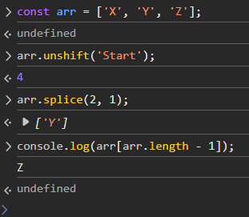
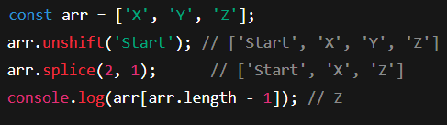
Day 4: DOM Recap – What, Why & How
✅ Answer 3 – Array Methods
Notes:
Syntax is crucial in programming for several reasons:
Clarity and Readability: Syntax provides a structured way to write code, making it easier for programmers to read and understand. Consistent syntax helps convey the intended logic and flow of the program.
Error Reduction: Strict syntax rules help catch errors early in the development process. If the syntax is incorrect, the compiler or interpreter will typically provide feedback, preventing the program from running until the issues are resolved.
Language Definition: Each programming language has its own syntax that defines how code is structured. This syntax is part of what distinguishes one language from another and defines how programmers interact with the language's features.
Tooling and Support: Many development tools, such as IDEs and linters, rely on the syntax of a programming language to provide features like code completion, syntax highlighting, and error detection. Changing the syntax could disrupt these tools' effectiveness.

Slide 15
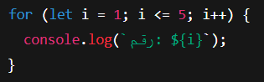
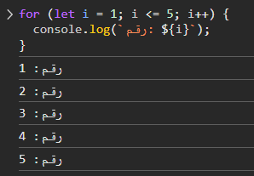
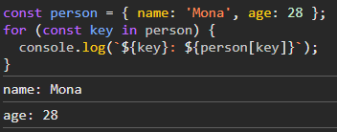
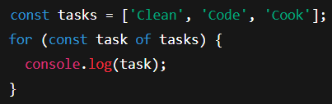
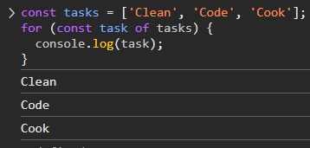
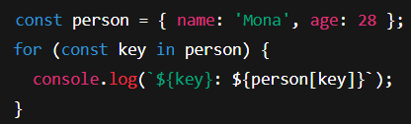
Day 4: 🕚 Loops – Automate Everything
الـ loops بتوفر علينا التكرار اليدوي. بدل ما نكتب نفس الكود عشر مرات، نكتبه مرة وحدة ويتكرر. نستخدمه مع المصفوفات أو الأرقام أو الكائنات.
Notes:
Syntax is crucial in programming for several reasons:
Clarity and Readability: Syntax provides a structured way to write code, making it easier for programmers to read and understand. Consistent syntax helps convey the intended logic and flow of the program.
Error Reduction: Strict syntax rules help catch errors early in the development process. If the syntax is incorrect, the compiler or interpreter will typically provide feedback, preventing the program from running until the issues are resolved.
Language Definition: Each programming language has its own syntax that defines how code is structured. This syntax is part of what distinguishes one language from another and defines how programmers interact with the language's features.
Tooling and Support: Many development tools, such as IDEs and linters, rely on the syntax of a programming language to provide features like code completion, syntax highlighting, and error detection. Changing the syntax could disrupt these tools' effectiveness.

Slide 16
Day 4: DOM Recap – What, Why & How
🧠 Task 4 – Loops
❓السؤال:
اطبع كل حرف في الكلمة “ JAVASCRIPT" في سطر منفصل باستخدام for loop.
ضيف لمعلوماتك:-
String.length = عدد حروف الكلمة
String = Array of characters
Notes:
Syntax is crucial in programming for several reasons:
Clarity and Readability: Syntax provides a structured way to write code, making it easier for programmers to read and understand. Consistent syntax helps convey the intended logic and flow of the program.
Error Reduction: Strict syntax rules help catch errors early in the development process. If the syntax is incorrect, the compiler or interpreter will typically provide feedback, preventing the program from running until the issues are resolved.
Language Definition: Each programming language has its own syntax that defines how code is structured. This syntax is part of what distinguishes one language from another and defines how programmers interact with the language's features.
Tooling and Support: Many development tools, such as IDEs and linters, rely on the syntax of a programming language to provide features like code completion, syntax highlighting, and error detection. Changing the syntax could disrupt these tools' effectiveness.

Slide 17
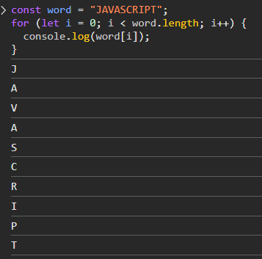
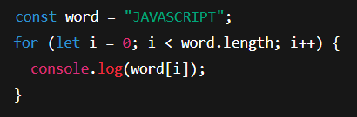
Day 4: DOM Recap – What, Why & How
✅ Answer 4 – Loops
Notes:
Syntax is crucial in programming for several reasons:
Clarity and Readability: Syntax provides a structured way to write code, making it easier for programmers to read and understand. Consistent syntax helps convey the intended logic and flow of the program.
Error Reduction: Strict syntax rules help catch errors early in the development process. If the syntax is incorrect, the compiler or interpreter will typically provide feedback, preventing the program from running until the issues are resolved.
Language Definition: Each programming language has its own syntax that defines how code is structured. This syntax is part of what distinguishes one language from another and defines how programmers interact with the language's features.
Tooling and Support: Many development tools, such as IDEs and linters, rely on the syntax of a programming language to provide features like code completion, syntax highlighting, and error detection. Changing the syntax could disrupt these tools' effectiveness.

Slide 18
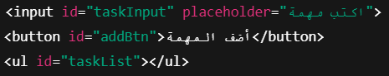
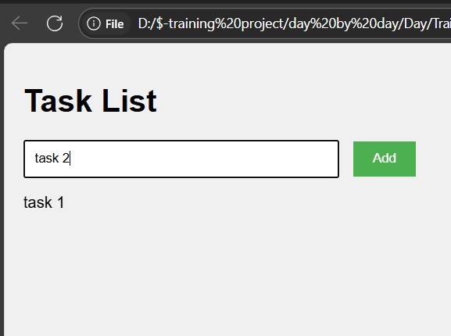
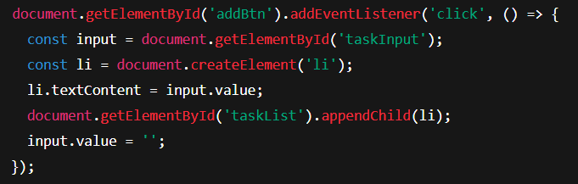
Day 4:🕛 Slide 5: Build Task List with DOM Only 📝
خلينا نطبّق اللي تعلمناه في الـ DOM ونعمل صفحة بسيطة فيها إدخال مهمة وزر لإضافتها لقائمة. بس خد بالك: لو عملت ريـلود هتضيع كل حاجة… ليه؟ لأننا لسه مخزّناش البيانات في مكان دائم!
Notes:
Syntax is crucial in programming for several reasons:
Clarity and Readability: Syntax provides a structured way to write code, making it easier for programmers to read and understand. Consistent syntax helps convey the intended logic and flow of the program.
Error Reduction: Strict syntax rules help catch errors early in the development process. If the syntax is incorrect, the compiler or interpreter will typically provide feedback, preventing the program from running until the issues are resolved.
Language Definition: Each programming language has its own syntax that defines how code is structured. This syntax is part of what distinguishes one language from another and defines how programmers interact with the language's features.
Tooling and Support: Many development tools, such as IDEs and linters, rely on the syntax of a programming language to provide features like code completion, syntax highlighting, and error detection. Changing the syntax could disrupt these tools' effectiveness.

Slide 19
Day 4: DOM Recap – What, Why & How
🧠 Task 5 – Task List DOM
❓ السؤال:
صمّم صفحة فيها إدخال مهمة وزر، وكل ضغطة على الزر تضيف <li> جديد داخل <ul> ويظهر على الصفحة مباشرة.
Notes:
Syntax is crucial in programming for several reasons:
Clarity and Readability: Syntax provides a structured way to write code, making it easier for programmers to read and understand. Consistent syntax helps convey the intended logic and flow of the program.
Error Reduction: Strict syntax rules help catch errors early in the development process. If the syntax is incorrect, the compiler or interpreter will typically provide feedback, preventing the program from running until the issues are resolved.
Language Definition: Each programming language has its own syntax that defines how code is structured. This syntax is part of what distinguishes one language from another and defines how programmers interact with the language's features.
Tooling and Support: Many development tools, such as IDEs and linters, rely on the syntax of a programming language to provide features like code completion, syntax highlighting, and error detection. Changing the syntax could disrupt these tools' effectiveness.

Slide 20
Day 4: DOM Recap – What, Why & How
✅ Answer 5 – Task List DOM html
Previous slide
Notes:
Syntax is crucial in programming for several reasons:
Clarity and Readability: Syntax provides a structured way to write code, making it easier for programmers to read and understand. Consistent syntax helps convey the intended logic and flow of the program.
Error Reduction: Strict syntax rules help catch errors early in the development process. If the syntax is incorrect, the compiler or interpreter will typically provide feedback, preventing the program from running until the issues are resolved.
Language Definition: Each programming language has its own syntax that defines how code is structured. This syntax is part of what distinguishes one language from another and defines how programmers interact with the language's features.
Tooling and Support: Many development tools, such as IDEs and linters, rely on the syntax of a programming language to provide features like code completion, syntax highlighting, and error detection. Changing the syntax could disrupt these tools' effectiveness.

Slide 21

🍜 Lunch
Notes:
Syntax is crucial in programming for several reasons:
Clarity and Readability: Syntax provides a structured way to write code, making it easier for programmers to read and understand. Consistent syntax helps convey the intended logic and flow of the program.
Error Reduction: Strict syntax rules help catch errors early in the development process. If the syntax is incorrect, the compiler or interpreter will typically provide feedback, preventing the program from running until the issues are resolved.
Language Definition: Each programming language has its own syntax that defines how code is structured. This syntax is part of what distinguishes one language from another and defines how programmers interact with the language's features.
Tooling and Support: Many development tools, such as IDEs and linters, rely on the syntax of a programming language to provide features like code completion, syntax highlighting, and error detection. Changing the syntax could disrupt these tools' effectiveness.

Slide 22
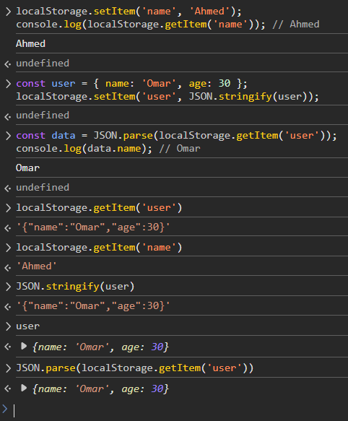
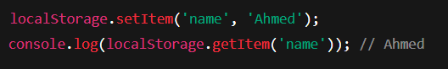
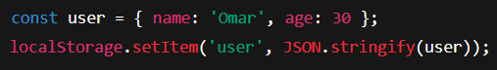
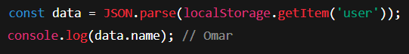
Day 4:🕐 What is localStorage? 💾
localStorage عبارة عن مساحة تخزين دائمة داخل المتصفح. بتسمح لك تحفظ بيانات المستخدم حتى بعد ما يعمل Refresh أو يخرج ويرجع.
Notes:
Syntax is crucial in programming for several reasons:
Clarity and Readability: Syntax provides a structured way to write code, making it easier for programmers to read and understand. Consistent syntax helps convey the intended logic and flow of the program.
Error Reduction: Strict syntax rules help catch errors early in the development process. If the syntax is incorrect, the compiler or interpreter will typically provide feedback, preventing the program from running until the issues are resolved.
Language Definition: Each programming language has its own syntax that defines how code is structured. This syntax is part of what distinguishes one language from another and defines how programmers interact with the language's features.
Tooling and Support: Many development tools, such as IDEs and linters, rely on the syntax of a programming language to provide features like code completion, syntax highlighting, and error detection. Changing the syntax could disrupt these tools' effectiveness.

Slide 23
Day 4: DOM Recap – What, Why & How
🧠 Task 6 – localStorage
❓ السؤال:
خزّن اسم المستخدم ولونه المفضل داخل localStorage، وبعدها اعرضهم باستخدام console.log().
Notes:
Syntax is crucial in programming for several reasons:
Clarity and Readability: Syntax provides a structured way to write code, making it easier for programmers to read and understand. Consistent syntax helps convey the intended logic and flow of the program.
Error Reduction: Strict syntax rules help catch errors early in the development process. If the syntax is incorrect, the compiler or interpreter will typically provide feedback, preventing the program from running until the issues are resolved.
Language Definition: Each programming language has its own syntax that defines how code is structured. This syntax is part of what distinguishes one language from another and defines how programmers interact with the language's features.
Tooling and Support: Many development tools, such as IDEs and linters, rely on the syntax of a programming language to provide features like code completion, syntax highlighting, and error detection. Changing the syntax could disrupt these tools' effectiveness.

Slide 24
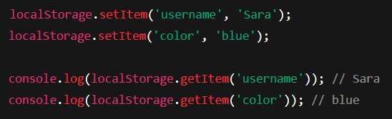
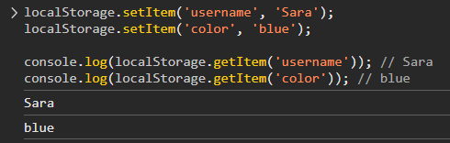
Day 4: DOM Recap – What, Why & How
✅ Answer 6 – localStorage
Notes:
Syntax is crucial in programming for several reasons:
Clarity and Readability: Syntax provides a structured way to write code, making it easier for programmers to read and understand. Consistent syntax helps convey the intended logic and flow of the program.
Error Reduction: Strict syntax rules help catch errors early in the development process. If the syntax is incorrect, the compiler or interpreter will typically provide feedback, preventing the program from running until the issues are resolved.
Language Definition: Each programming language has its own syntax that defines how code is structured. This syntax is part of what distinguishes one language from another and defines how programmers interact with the language's features.
Tooling and Support: Many development tools, such as IDEs and linters, rely on the syntax of a programming language to provide features like code completion, syntax highlighting, and error detection. Changing the syntax could disrupt these tools' effectiveness.

Slide 25
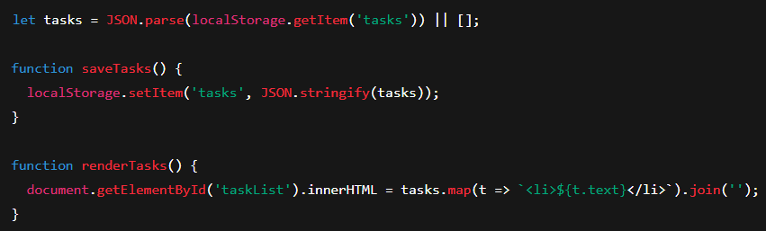
Day 4:🕜 Making Your Task List Permanent 🔒
دلوقتي هنخلي المهمات محفوظة! أي مهمة يكتبها المستخدم لازم تتسجّل في localStorage، ولما الصفحة تفتح تتعرض تلقائيًا.
Notes:
Syntax is crucial in programming for several reasons:
Clarity and Readability: Syntax provides a structured way to write code, making it easier for programmers to read and understand. Consistent syntax helps convey the intended logic and flow of the program.
Error Reduction: Strict syntax rules help catch errors early in the development process. If the syntax is incorrect, the compiler or interpreter will typically provide feedback, preventing the program from running until the issues are resolved.
Language Definition: Each programming language has its own syntax that defines how code is structured. This syntax is part of what distinguishes one language from another and defines how programmers interact with the language's features.
Tooling and Support: Many development tools, such as IDEs and linters, rely on the syntax of a programming language to provide features like code completion, syntax highlighting, and error detection. Changing the syntax could disrupt these tools' effectiveness.

Slide 26
Day 4: DOM Recap – What, Why & How
🧠 Task 7 – Persistent Tasks
❓ السؤال:
عدّل قائمة المهام بتاعتك بحيث أي مهمة تُكتب يتم حفظها في localStorage، وتظهر تلقائيًا عند فتح الصفحة.
Notes:
Syntax is crucial in programming for several reasons:
Clarity and Readability: Syntax provides a structured way to write code, making it easier for programmers to read and understand. Consistent syntax helps convey the intended logic and flow of the program.
Error Reduction: Strict syntax rules help catch errors early in the development process. If the syntax is incorrect, the compiler or interpreter will typically provide feedback, preventing the program from running until the issues are resolved.
Language Definition: Each programming language has its own syntax that defines how code is structured. This syntax is part of what distinguishes one language from another and defines how programmers interact with the language's features.
Tooling and Support: Many development tools, such as IDEs and linters, rely on the syntax of a programming language to provide features like code completion, syntax highlighting, and error detection. Changing the syntax could disrupt these tools' effectiveness.

Slide 27
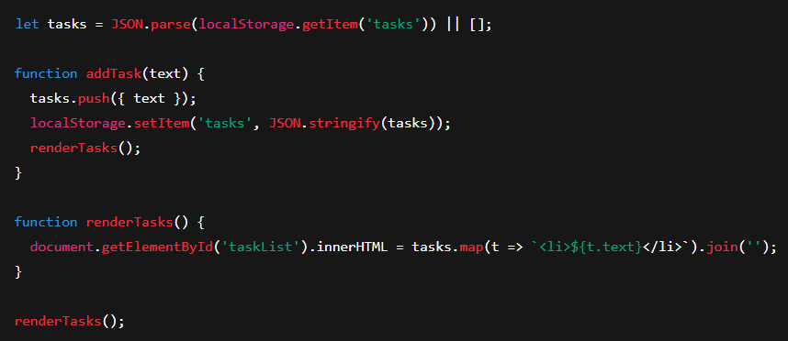
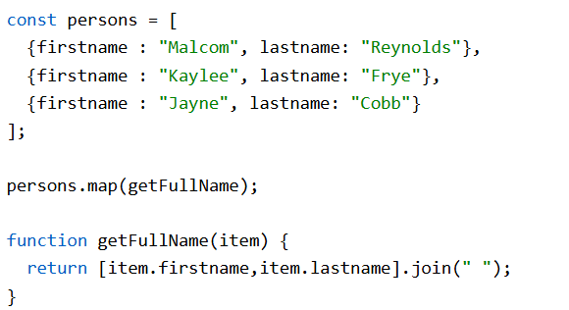
Day 4: DOM Recap – What, Why & How
✅ Answer 7 – Persistent Tasks
Notes:
Syntax is crucial in programming for several reasons:
Clarity and Readability: Syntax provides a structured way to write code, making it easier for programmers to read and understand. Consistent syntax helps convey the intended logic and flow of the program.
Error Reduction: Strict syntax rules help catch errors early in the development process. If the syntax is incorrect, the compiler or interpreter will typically provide feedback, preventing the program from running until the issues are resolved.
Language Definition: Each programming language has its own syntax that defines how code is structured. This syntax is part of what distinguishes one language from another and defines how programmers interact with the language's features.
Tooling and Support: Many development tools, such as IDEs and linters, rely on the syntax of a programming language to provide features like code completion, syntax highlighting, and error detection. Changing the syntax could disrupt these tools' effectiveness.

Slide 28
🍵 Break
Notes:
Syntax is crucial in programming for several reasons:
Clarity and Readability: Syntax provides a structured way to write code, making it easier for programmers to read and understand. Consistent syntax helps convey the intended logic and flow of the program.
Error Reduction: Strict syntax rules help catch errors early in the development process. If the syntax is incorrect, the compiler or interpreter will typically provide feedback, preventing the program from running until the issues are resolved.
Language Definition: Each programming language has its own syntax that defines how code is structured. This syntax is part of what distinguishes one language from another and defines how programmers interact with the language's features.
Tooling and Support: Many development tools, such as IDEs and linters, rely on the syntax of a programming language to provide features like code completion, syntax highlighting, and error detection. Changing the syntax could disrupt these tools' effectiveness.

Slide 29
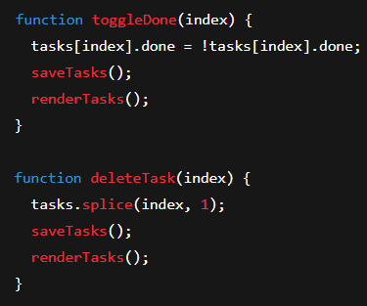
Day 4:🕝CRUD Operations – Update & Delete 🛠️
كل برنامج حقيقي لازم يكون فيه CRUD :-
✅ Create: إضافة مهمة
🔄 Read: عرضها
✏️ Update: تعديل/تغيير حالة
❌ Delete: حذف
Notes:
Syntax is crucial in programming for several reasons:
Clarity and Readability: Syntax provides a structured way to write code, making it easier for programmers to read and understand. Consistent syntax helps convey the intended logic and flow of the program.
Error Reduction: Strict syntax rules help catch errors early in the development process. If the syntax is incorrect, the compiler or interpreter will typically provide feedback, preventing the program from running until the issues are resolved.
Language Definition: Each programming language has its own syntax that defines how code is structured. This syntax is part of what distinguishes one language from another and defines how programmers interact with the language's features.
Tooling and Support: Many development tools, such as IDEs and linters, rely on the syntax of a programming language to provide features like code completion, syntax highlighting, and error detection. Changing the syntax could disrupt these tools' effectiveness.

Slide 30
Day 4: DOM Recap – What, Why & How
🧠 Task 8 – Full CRUD
❓ السؤال:
أضف زر "حذف" بجانب كل مهمة، وخلي المستخدم يقدر يضغط عليه لحذفها من الصفحة وlocalStorage.
Notes:
Syntax is crucial in programming for several reasons:
Clarity and Readability: Syntax provides a structured way to write code, making it easier for programmers to read and understand. Consistent syntax helps convey the intended logic and flow of the program.
Error Reduction: Strict syntax rules help catch errors early in the development process. If the syntax is incorrect, the compiler or interpreter will typically provide feedback, preventing the program from running until the issues are resolved.
Language Definition: Each programming language has its own syntax that defines how code is structured. This syntax is part of what distinguishes one language from another and defines how programmers interact with the language's features.
Tooling and Support: Many development tools, such as IDEs and linters, rely on the syntax of a programming language to provide features like code completion, syntax highlighting, and error detection. Changing the syntax could disrupt these tools' effectiveness.

Slide 31
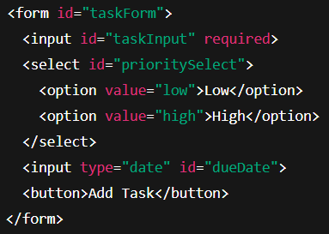
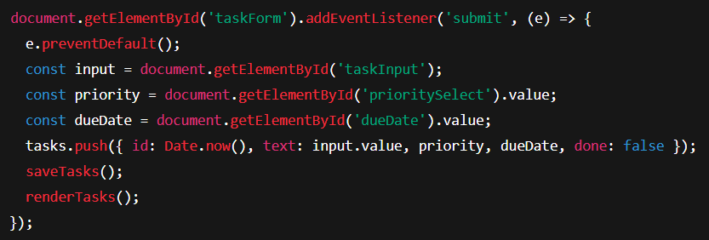
"Day 4: Lab – Full UI with Form, Priority, Date"
“Let’s now build a real-world UI—tasks with priority, due date, and full form submission.”
Notes:
Syntax is crucial in programming for several reasons:
Clarity and Readability: Syntax provides a structured way to write code, making it easier for programmers to read and understand. Consistent syntax helps convey the intended logic and flow of the program.
Error Reduction: Strict syntax rules help catch errors early in the development process. If the syntax is incorrect, the compiler or interpreter will typically provide feedback, preventing the program from running until the issues are resolved.
Language Definition: Each programming language has its own syntax that defines how code is structured. This syntax is part of what distinguishes one language from another and defines how programmers interact with the language's features.
Tooling and Support: Many development tools, such as IDEs and linters, rely on the syntax of a programming language to provide features like code completion, syntax highlighting, and error detection. Changing the syntax could disrupt these tools' effectiveness.

Slide 32
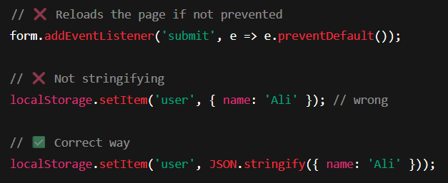
"Day 4: Common Mistakes"
“Even pros make mistakes. Let’s look at common bugs and how to avoid them.”
Notes:
Syntax is crucial in programming for several reasons:
Clarity and Readability: Syntax provides a structured way to write code, making it easier for programmers to read and understand. Consistent syntax helps convey the intended logic and flow of the program.
Error Reduction: Strict syntax rules help catch errors early in the development process. If the syntax is incorrect, the compiler or interpreter will typically provide feedback, preventing the program from running until the issues are resolved.
Language Definition: Each programming language has its own syntax that defines how code is structured. This syntax is part of what distinguishes one language from another and defines how programmers interact with the language's features.
Tooling and Support: Many development tools, such as IDEs and linters, rely on the syntax of a programming language to provide features like code completion, syntax highlighting, and error detection. Changing the syntax could disrupt these tools' effectiveness.

Slide 33
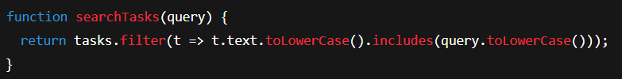
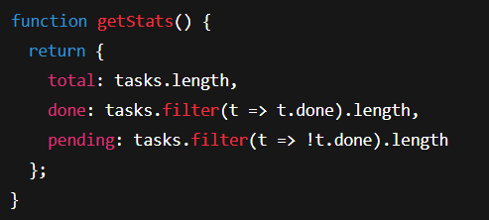
"Day 4: Mini Project + Stats + Search"
“Wrap-up challenge: add search, task stats, sorting. This will prepare you for real-world apps.”
Notes:
Syntax is crucial in programming for several reasons:
Clarity and Readability: Syntax provides a structured way to write code, making it easier for programmers to read and understand. Consistent syntax helps convey the intended logic and flow of the program.
Error Reduction: Strict syntax rules help catch errors early in the development process. If the syntax is incorrect, the compiler or interpreter will typically provide feedback, preventing the program from running until the issues are resolved.
Language Definition: Each programming language has its own syntax that defines how code is structured. This syntax is part of what distinguishes one language from another and defines how programmers interact with the language's features.
Tooling and Support: Many development tools, such as IDEs and linters, rely on the syntax of a programming language to provide features like code completion, syntax highlighting, and error detection. Changing the syntax could disrupt these tools' effectiveness.

Slide 34

"Day 4: 🧾 Slide 10: Summary Slide – What We Learned "
✅ التعامل مع DOM
📦 استخدام المصفوفات Array
🔁 تكرار البيانات باستخدام Loops
💾 تخزين البيانات في localStorage
🛠️ إنشاء CRUD Task App
🔍 بحث وتصفية وعرض المهام بشكل واقعي
Notes:
Syntax is crucial in programming for several reasons:
Clarity and Readability: Syntax provides a structured way to write code, making it easier for programmers to read and understand. Consistent syntax helps convey the intended logic and flow of the program.
Error Reduction: Strict syntax rules help catch errors early in the development process. If the syntax is incorrect, the compiler or interpreter will typically provide feedback, preventing the program from running until the issues are resolved.
Language Definition: Each programming language has its own syntax that defines how code is structured. This syntax is part of what distinguishes one language from another and defines how programmers interact with the language's features.
Tooling and Support: Many development tools, such as IDEs and linters, rely on the syntax of a programming language to provide features like code completion, syntax highlighting, and error detection. Changing the syntax could disrupt these tools' effectiveness.

Slide 35
"Day 7: 🎯 Key Takeaways"
📂 Project Files
day7/
├── index.html
├── js/
│ ├── api/ # API modules
│ │ ├── cart.js # Shopping cart API
│ │ └── products.js
│ ├── lib/ # Utilities
│ └── main.js # App entry
└── README.md
Notes:
Syntax is crucial in programming for several reasons:
Clarity and Readability: Syntax provides a structured way to write code, making it easier for programmers to read and understand. Consistent syntax helps convey the intended logic and flow of the program.
Error Reduction: Strict syntax rules help catch errors early in the development process. If the syntax is incorrect, the compiler or interpreter will typically provide feedback, preventing the program from running until the issues are resolved.
Language Definition: Each programming language has its own syntax that defines how code is structured. This syntax is part of what distinguishes one language from another and defines how programmers interact with the language's features.
Tooling and Support: Many development tools, such as IDEs and linters, rely on the syntax of a programming language to provide features like code completion, syntax highlighting, and error detection. Changing the syntax could disrupt these tools' effectiveness.

Slide 36


The End
in the end I hope you understood all I said contact on :
https://www.facebook.com/abobakr143
https://wa.me/201113284597

